Slide 1

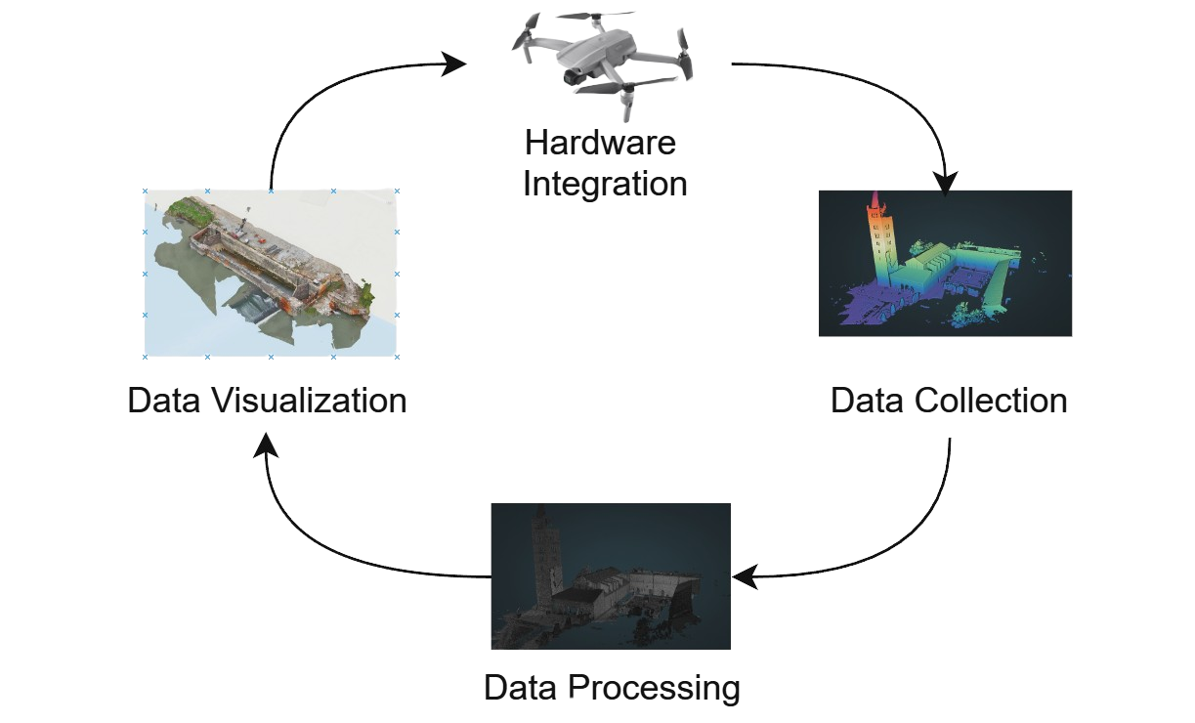
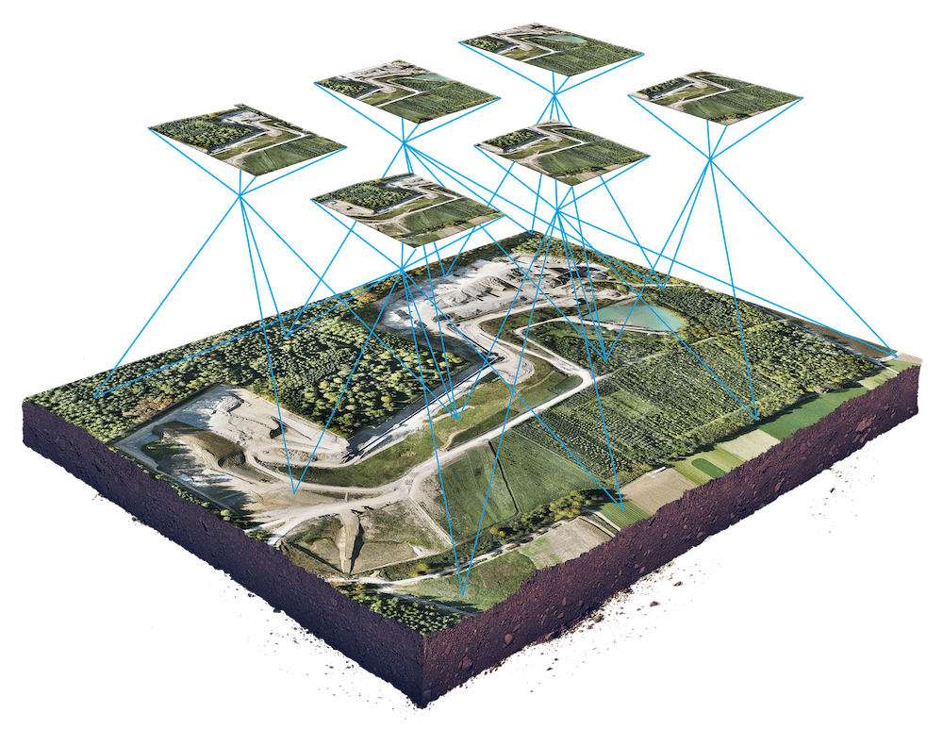
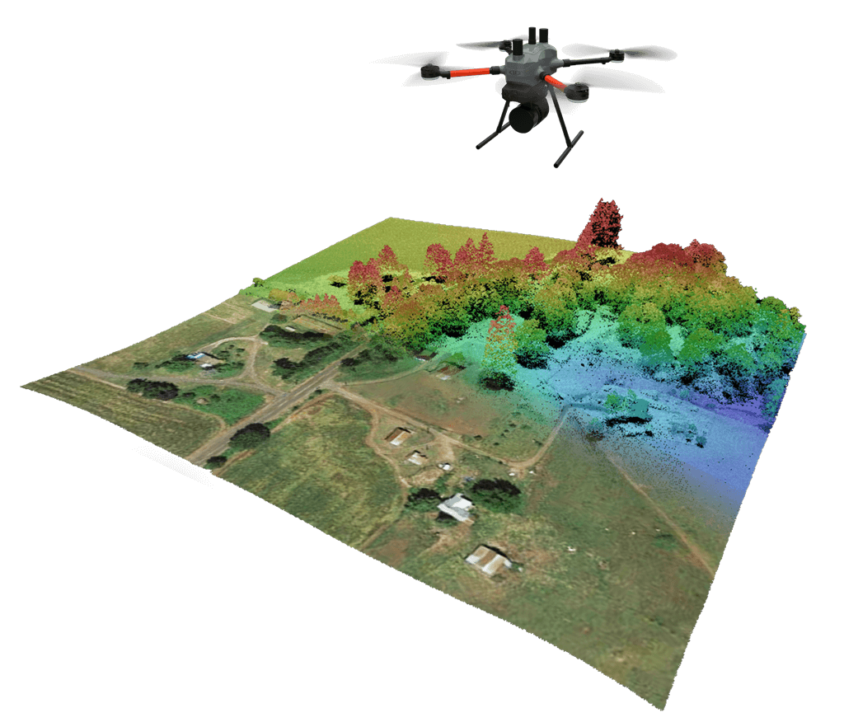
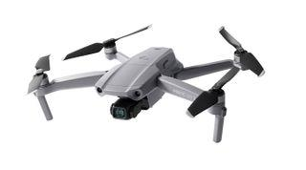
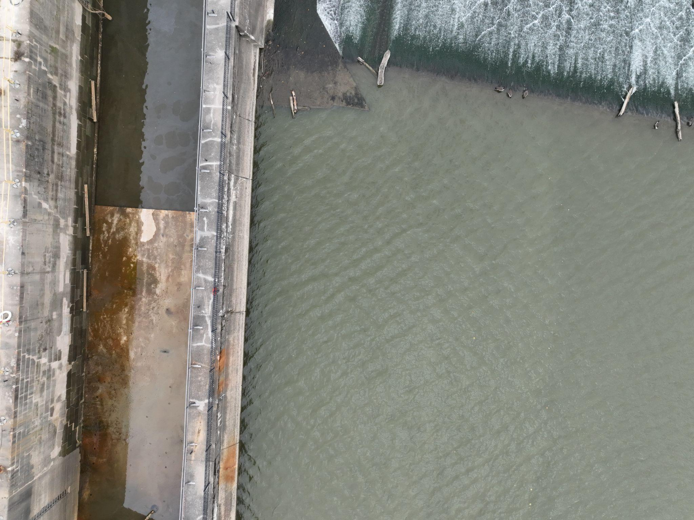
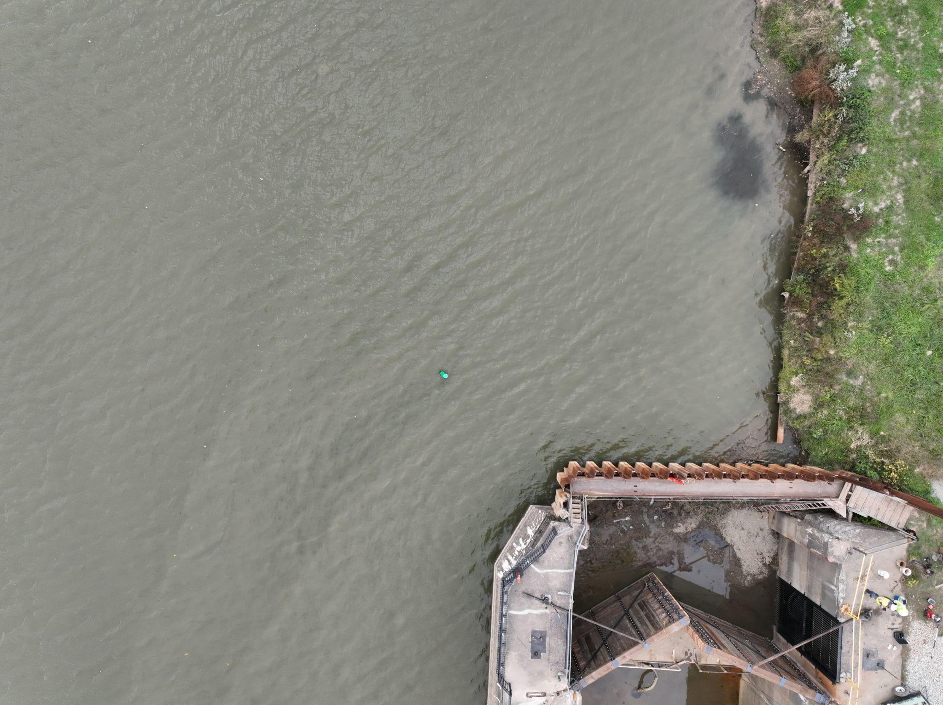
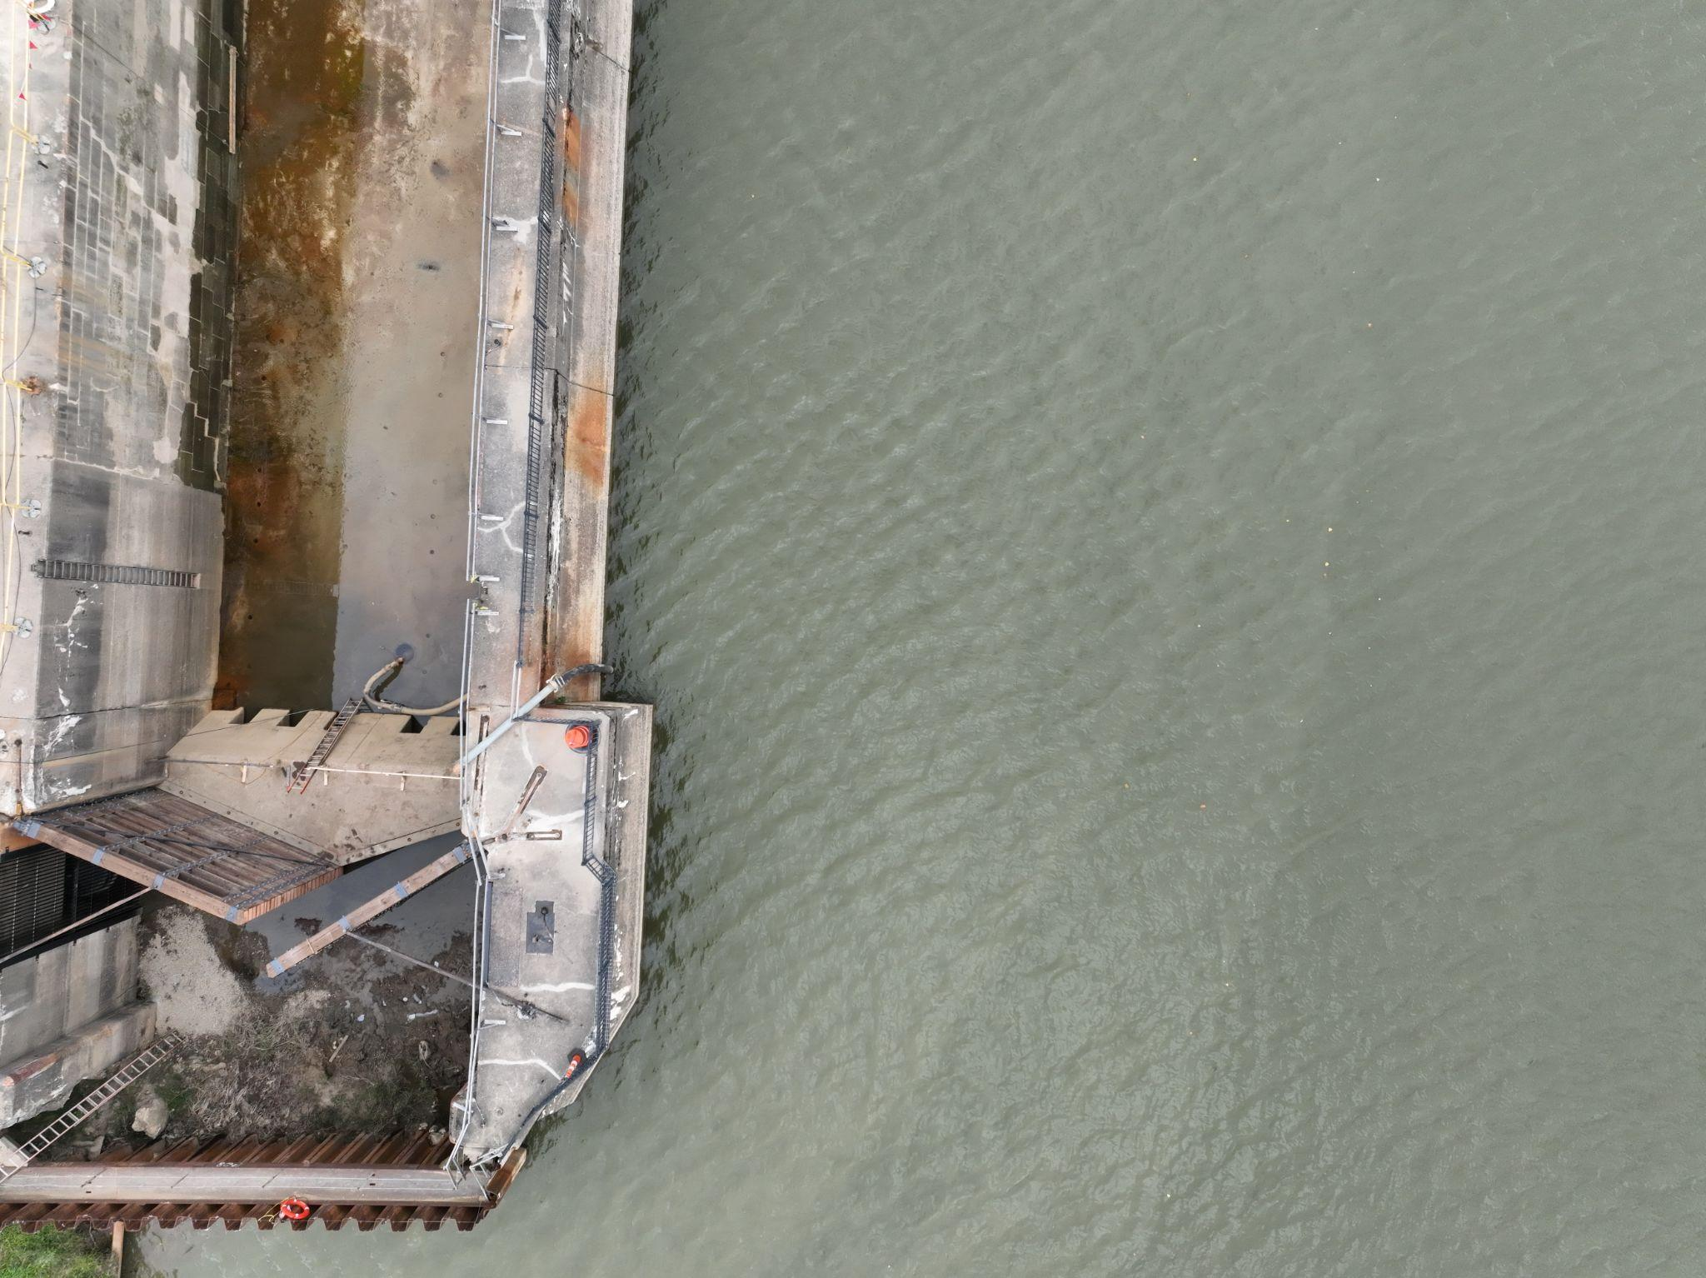
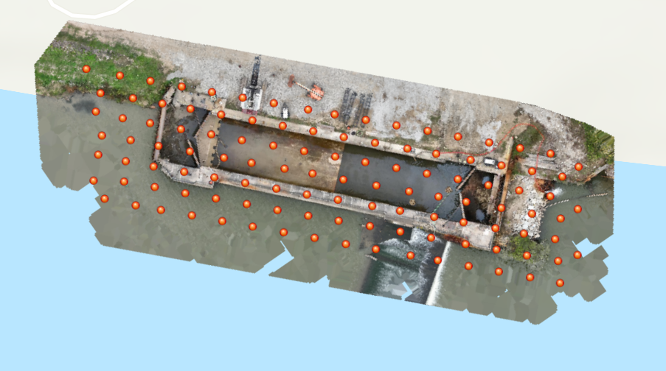
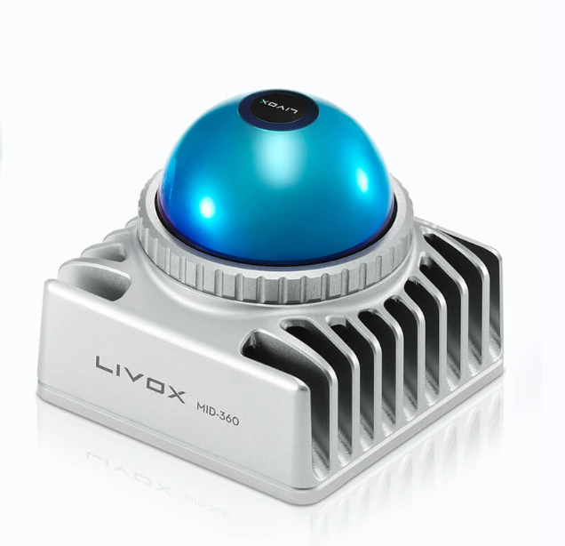
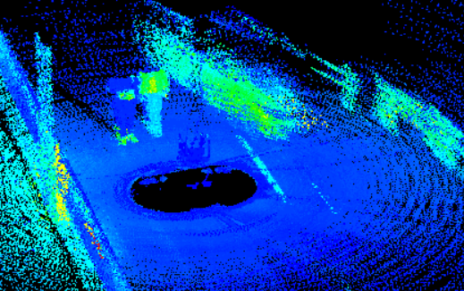
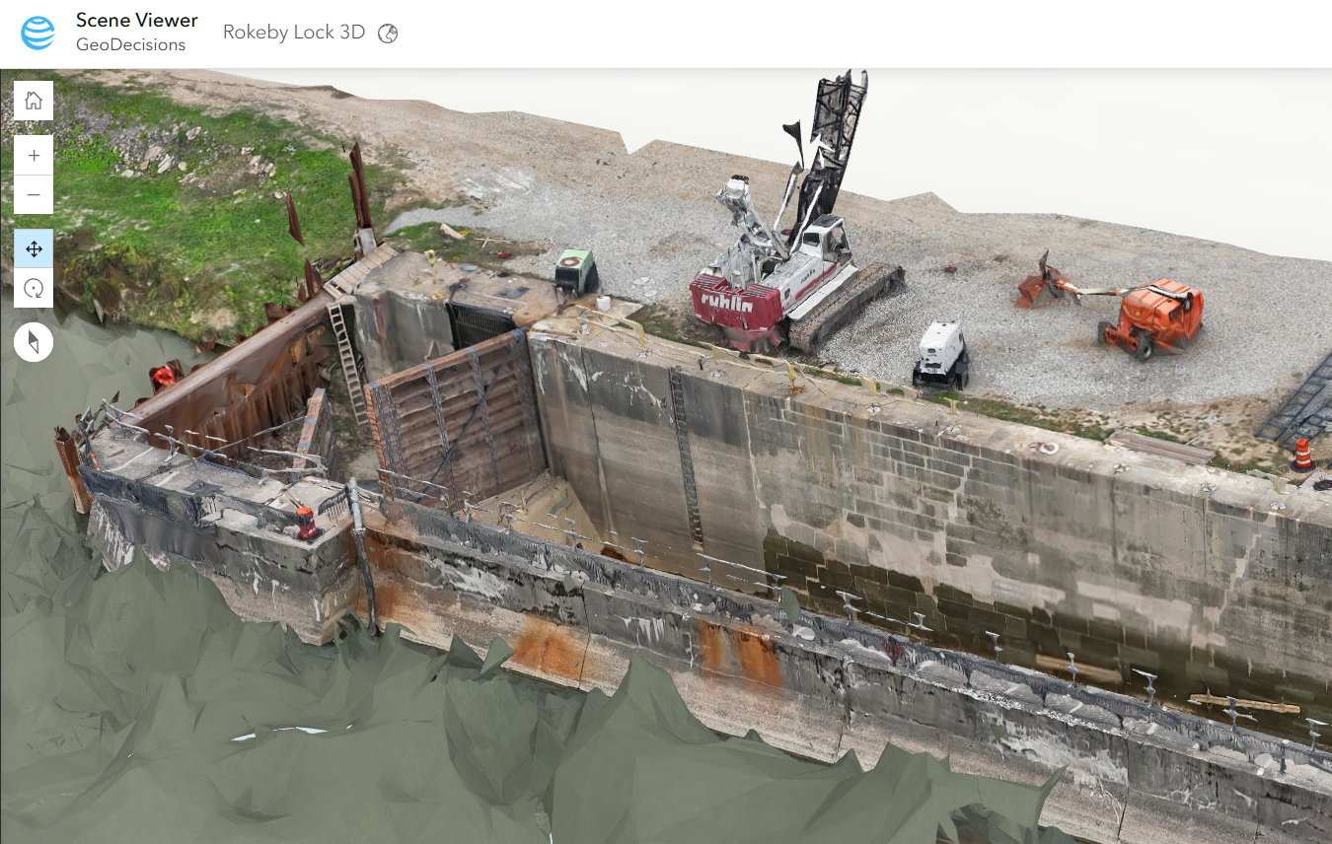
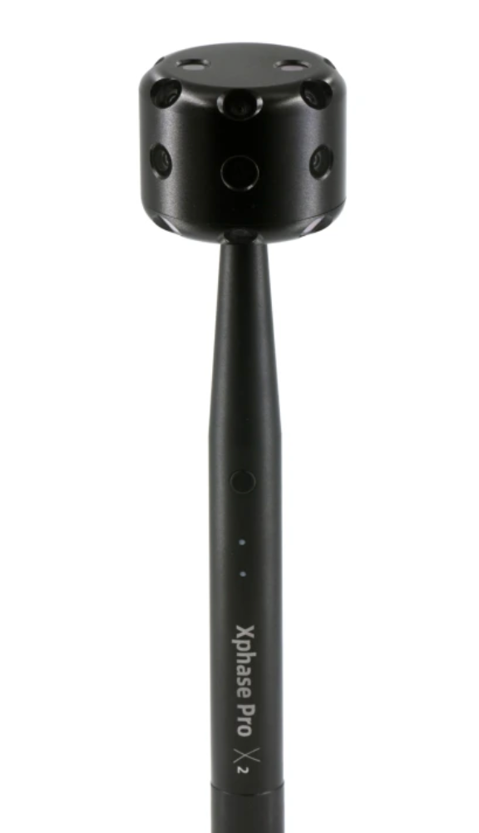
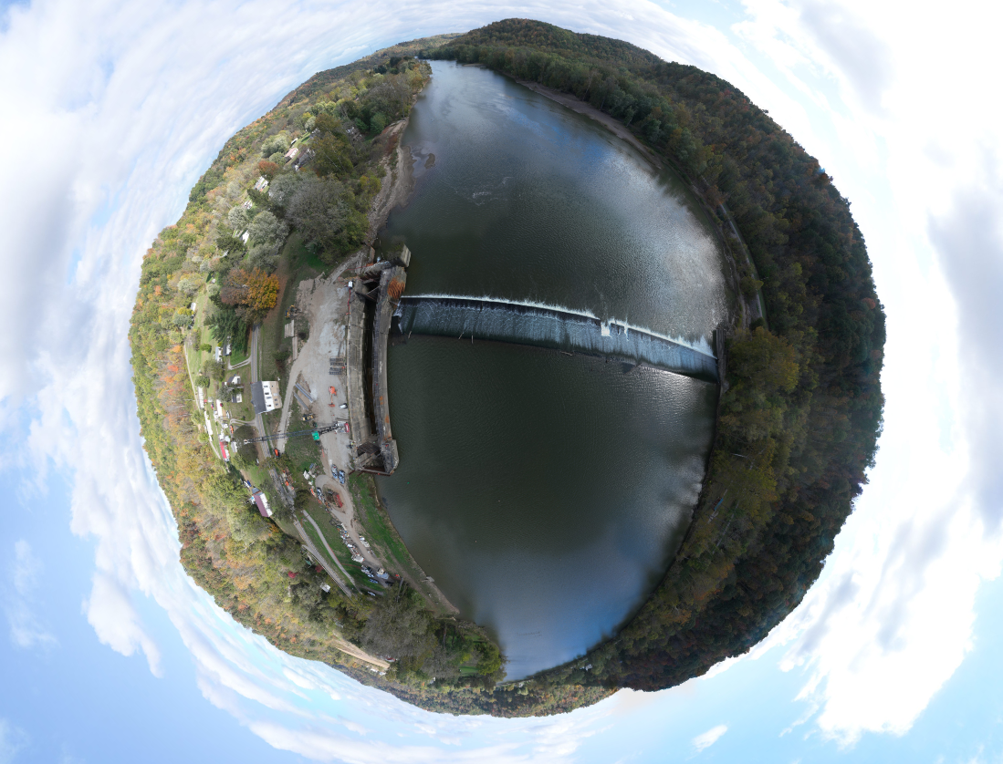
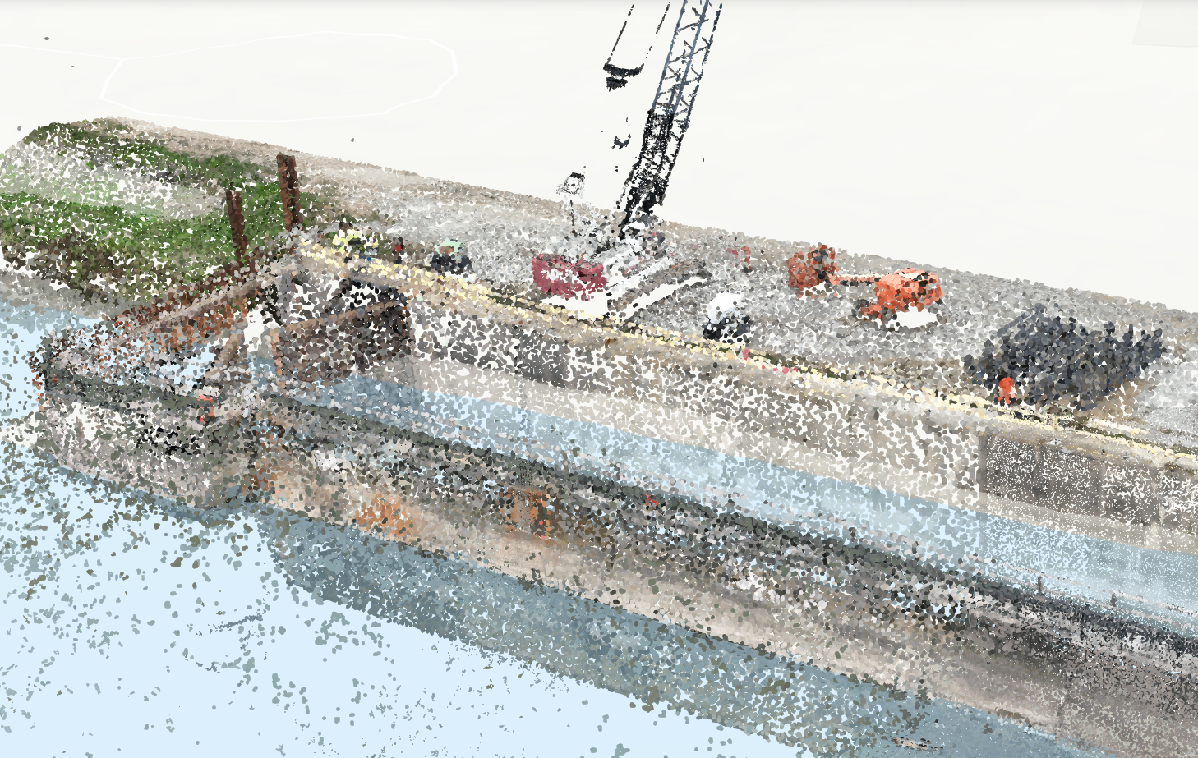
25-604
Aerial Precision: 3D Reality Capture and GIS Integration with Drone Technology
Team members: Adil Adil, Nathan Germain, Grady Beck, Colin Drake | Faculty adviser: Yuichi Motai PhD, Tamer Nadeem PhD | Sponsor: GeoDecisions
Problem Statement: This project aims to develop an efficient, replicable process for using drone technology to create 3D models of infrastructure worksites. By integrating photogrammetric and LiDAR-based imagery analysis with ESRI’s ArcGIS software suite, we aim to streamline data collection, processing, and visualization. Ultimately, this project will provide an in-house process to leverage in the ever-competitive geospatial sensing industry.
Photogrammetry is a method where 2D images are stitched together to approximate a 3D model (NOAA).
Wingtra
LiDAR (Light Detection And Ranging) is a sensing process that uses a pulsed laser to measure range to a given object (NOAA).
GeoCue
Components Used
Datasets Produced
Data Processed
Model Visualized
The DJI Mavic Air 2 combines high-resolution imaging with position data, capturing aerial photos ideal for precise mapping and surveying applications.
Datasets are then processed within the ArcGIS Reality suite, which allows for collating photogrammetry and LiDAR data into a single model
The completed model is placed into a virtual environment, ArcGIS Online, which provides stakeholders the means to view and manipulate models from anywhere in the world.
DJI Mavic Air 2
Latitude: 59.79959
Longitude: 30.73570
Altitude: 201.119
Georeferenced photographs
Mounted on a drone, the Livox Mid-360 LiDAR captures a high- resolution point cloud, giving accurate position data in order to form a depth map.
Livox Mid-360
Rendered orthomosaic view from drone photos
LiDAR data (displayed in Livox Viewer)
The 360° xPhase Pro camera enables precise capture of both static and dynamic models of objects, creating high-quality datasets ideal for detailed analysis and visualization.
Completed model within ArcGIS Online
As work on the site continues, repeated site surveys can be completed and the new data passed through the workflow to provide a time axis for reviewing progress.
xPhase Pro X2
360 panoramic image
LiDAR point cloud with color data
NOAA. Photogrammetry. NOAA Office of Ocean Exploration and Research. Retrieved November 3, 2024, from https://oceanexplorer.noaa.gov/technology/photogrammetry/photogrammetry.html
NOAA. What is LiDAR?. NOAA National Ocean Service. Retrieved November 3, 2024, from https://oceanservice.noaa.gov/facts/lidar.html
Wingtra. Best drone mapping software. Retrieved November 3, 2024, from https://wingtra.com/best-photogrammetry-software/
GeoCue. LP360 Drone: UAV LiDAR and photogrammetry data processing. Retrieved November 3, 2024, from https://www.lp360.com/product-line/lp360-drone/

